Slide 1

Global Course & Skill Sharing Platform
Connecting Students Worldwide for Learning & Growth

Slide 2

Addressing the Global Learning Gap
Students today face significant barriers in discovering international academic programs and sharing practical skills across borders. Our platform bridges this gap, fostering a truly interconnected learning environment.

Slide 3

Problem & Our Core Objectives
"Students lack a unified platform to explore global learning opportunities and exchange skills across countries."
1
Global Course & Skill Discovery
2
Integrated Communication
3
Future-Proof Scalability
Architect the platform for easy integration of advanced features like real-time chat.
Enable seamless sharing and discovery of courses and skills internationally.
Provide a robust discussion forum to facilitate peer-to-peer interaction.

Slide 4
Key Functional & Non-Functional Requirements
Functional Specifications
Non-Functional Considerations
User authentication & profile management
Secure and reliable authentication protocols
Post and browse international courses
Responsive and intuitive user interface
Dedicated skill-sharing module
Highly scalable backend architecture
Interactive discussion forums
Robust data integrity and privacy
Advanced search and filtering options

Slide 5



Technology Stack: Powering the Platform
Frontend
Backend
Database
HTML, CSS, JavaScript
Java (Spring Boot)
MySQL / MongoDB
Delivering a dynamic and engaging user experience.
Ensuring robust and high-performance server-side operations.
Flexible and scalable data storage for global content.
Our chosen stack combines proven enterprise technologies with modern development practices, ensuring a reliable and future-ready platform.

Slide 6
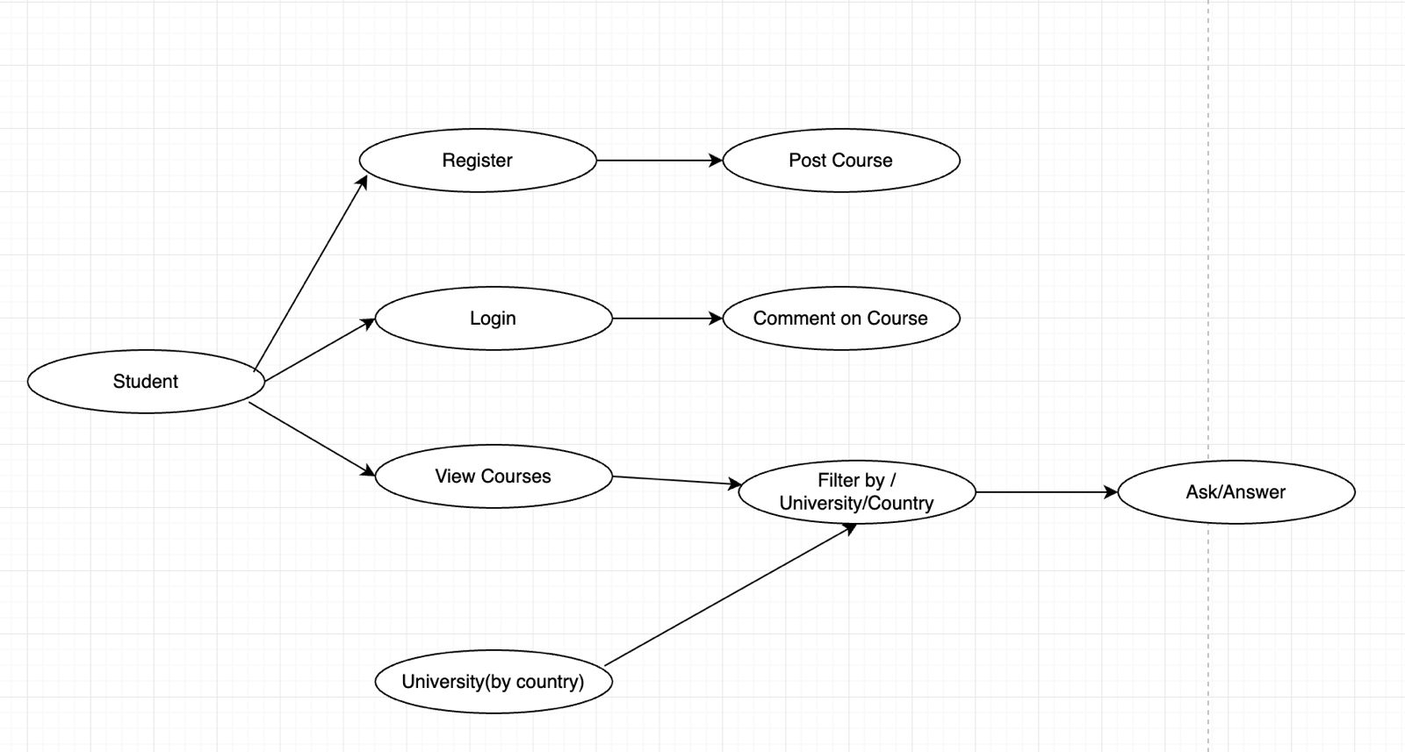
Use Case Diagram: How Users Interact
This diagram illustrates the primary interactions between our key actors – Students, Administrators, and the System – highlighting core functionalities like course management, skill sharing, and community engagement.

Slide 7
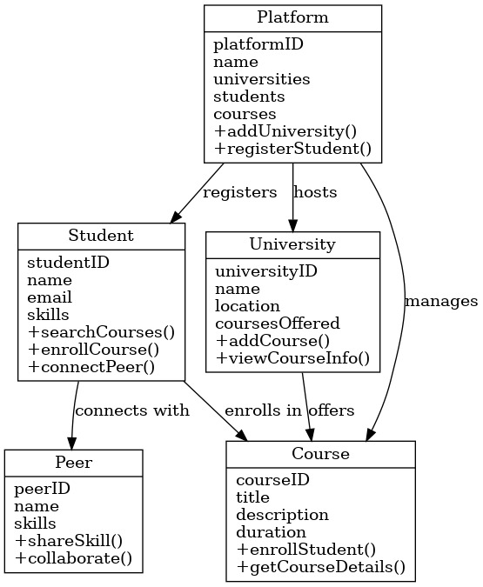
Class Diagram: System Structure
Our simplified class diagram showcases the fundamental entities and their relationships, forming the backbone of our platform's data model and logical structure.

Slide 8






Module Breakdown: A Layered Approach
Authentication Module
Secure user registration and login processes.
Course Module
Management and discovery of global academic courses.
Skill Sharing Module
Platform for users to offer and find practical skills.
Discussion Forum Module
Enabling active communication and community building.
Search & Filter Module
Intuitive tools for finding relevant content quickly.
Database Integration
Seamless data management and retrieval for all modules.

Slide 9




Future Scope: Evolving the Platform
Real-time Collaboration
Intelligent Recommendations
Integrate WebSockets for instant messaging and live chat functionalities, fostering immediate peer-to-peer connections.
Develop AI-based algorithms to offer personalized course and skill recommendations, enhancing user discovery and engagement.
Mobile Accessibility
Multilingual Support
Launch a dedicated mobile application for seamless on-the-go access, expanding our reach to a wider global audience.
Implement comprehensive localization features to make the platform accessible and user-friendly for non-English speakers.

Slide 10
Connecting Minds, Empowering Futures.
Our Global Course and Skill Sharing Platform is more than just a prototype; it's a vision for democratized education and skill development worldwide. We invite you to join us in building this transformative ecosystem.

Slide 11
TEAM
Godavarthi.Sudarsan
(RA2411047010098)
Hisham Khalid K
(RA2411047010096)
Amith A Shiji
(RA2411047010108)
Sahal Basheer
(RA2411047010115)

